Slide 1








Emojis to Sentence

Slide 2



Division of tasks (16,66%/person)
Kenneth Edgar 109006211 - Model Design, Datasets and Research
Vincent Leon 109006230 - Datasets, Research and GitHub Management
Dominick Matthew Singgih 施平治 109006210 - Visualizing Data, Datasets, and Research
Jansen Reynaldi Gautama 劉其生 109006240 - Model to Discord integration, Dataset and Research
Edbert Fuji Wijaya 110006164 - Dataset and Research
Rémi Antonucci X1120012 - Visualizing Data, Dataset, Research, and GitHub Management

Slide 3

Introduction
Can analyze and intepret combination of emojis and Reply with well-constructed sentences. Integrated With Discord Bot
Discord Bot
Notes:
What is EmojisBot?
We aim to design a bot that can analyze and interpret Combination of emojis we usually use to express something in text based message and respond with well-constructed sentences that convey the intended meaning behind the emojis. And we integrated it with A discord bot as our application in this project.

Slide 4

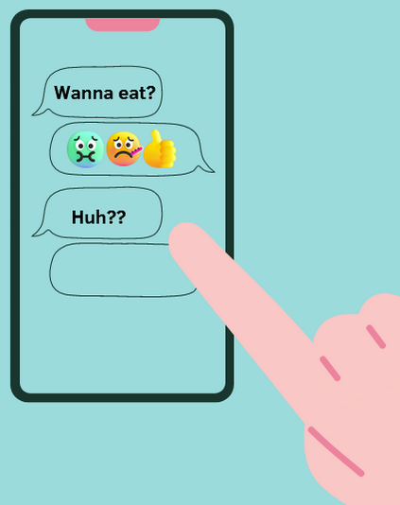


Motivation
Emojis become the bridge of our communications to express something in text-based conversations.
Sometimes, People still struggle to understand their partner's text emojis meaning to them.
It aims to fill this communication gap by providing an easy dynamic solution for social media interactions, especially in Discord.

Slide 5

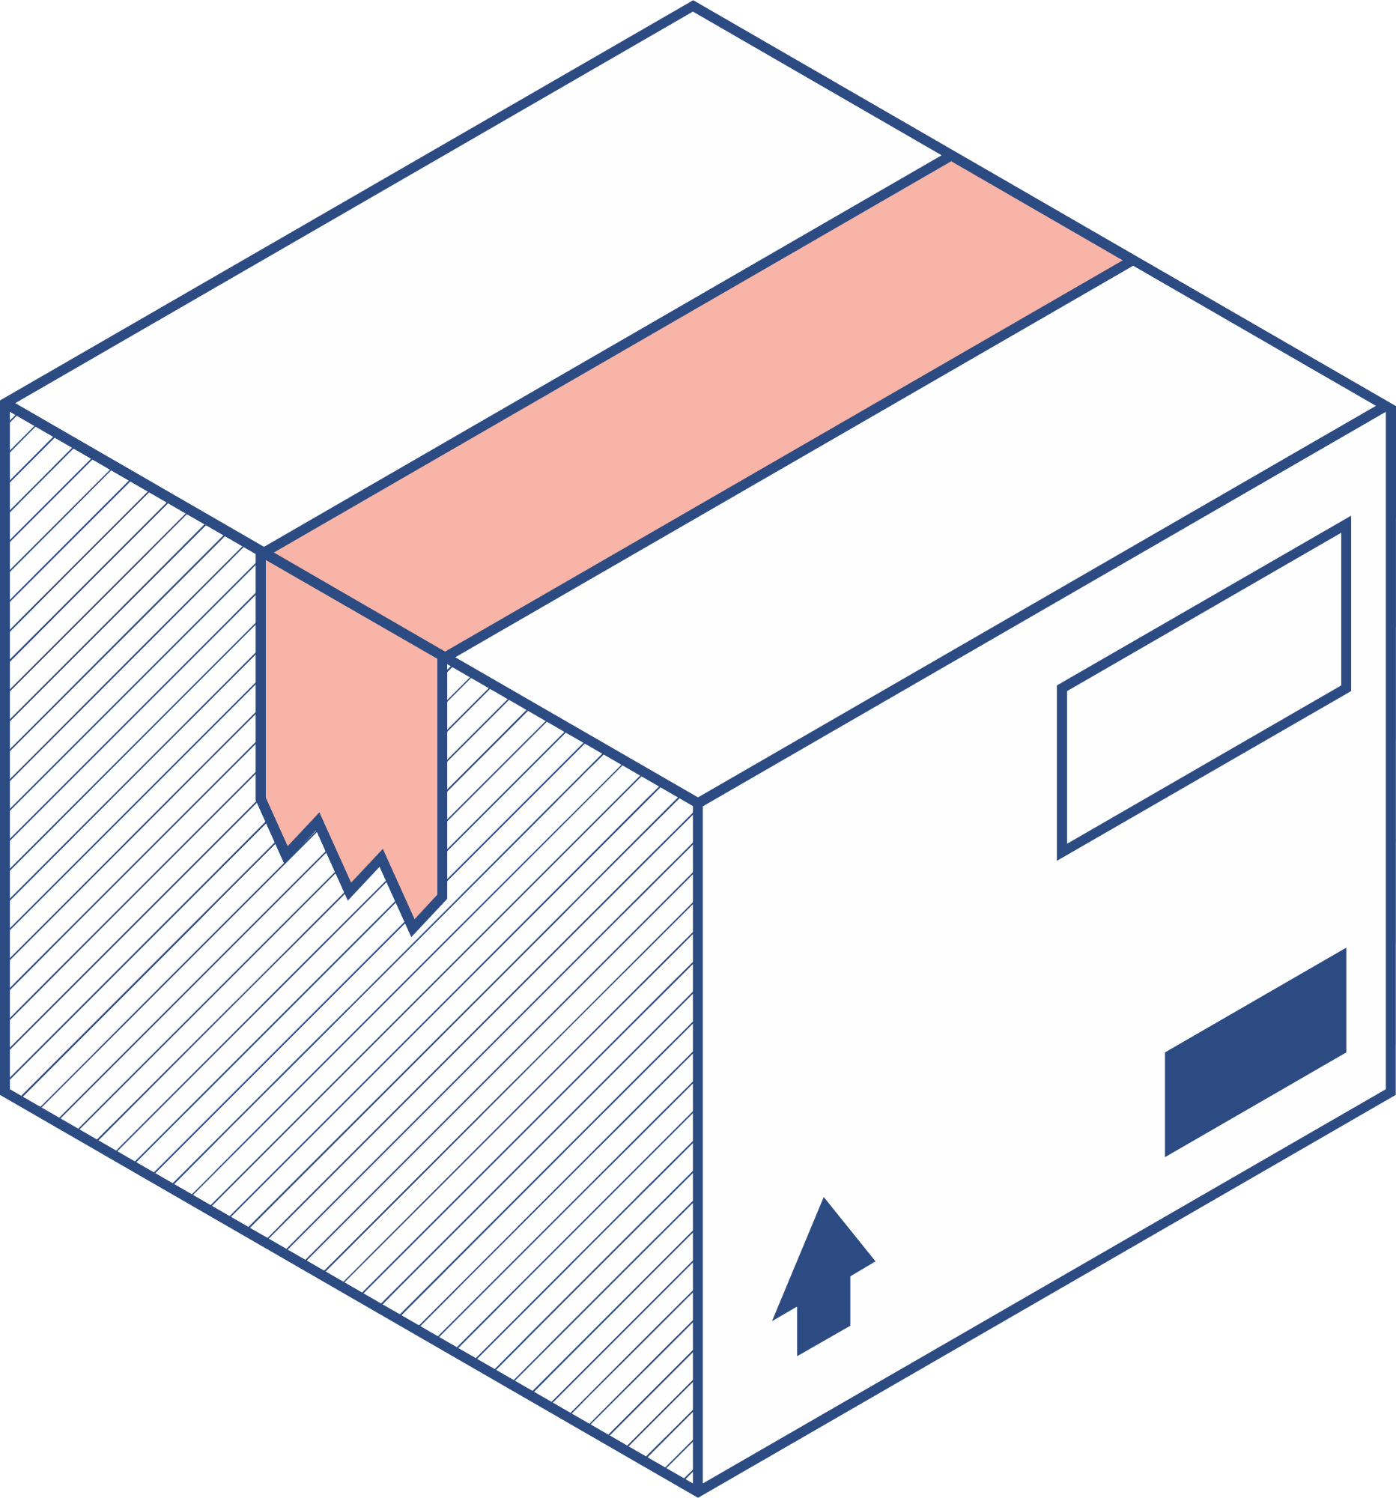


Features
Emoji to Sentence | Emoji to Response
Input : 3 Emojis Returns : A well constructed sentence that explains the the meaning behind those emojis combination. | Input: 3 Emojis Returns: A sentence that is a response to the 3 emojis, simulating a chatroom.

Slide 6
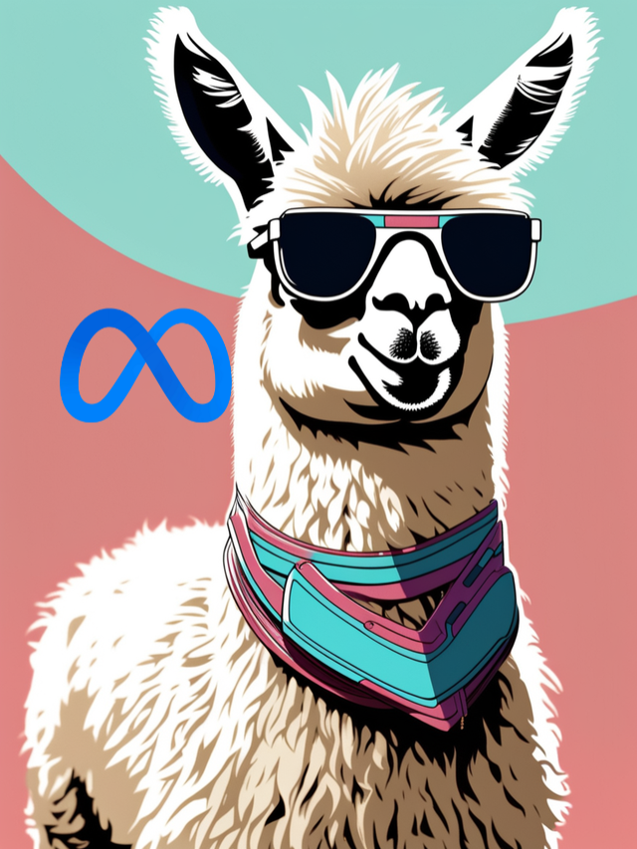
Methodology
Model = LlaMA 2 7b by META
LlaMA (Large Language Model Meta AI)
Llama 2 is Meta's open source large language model (LLM). It's basically the Facebook parent company's response to OpenAI's GPT models and Google's AI models like PaLM 2—but with one key difference: it's freely available for almost anyone to use for research and commercial purposes

Slide 7

But why LlaMA 2? why not GPT, PaLM 2 or any other LLMs?
LLaMa 2 is open source. (Transparency)
Computing Power : Run model locally in our computer (data privacy)

Slide 8

Workflow
Emoji as String Representation
Emoji Label (Text)
Our Model
Sentence

Slide 9
Source
No suitable datasets can be found online. So the datasets are custom made by us.
Input
Three random emojis in its string representation form
Output
Sentence
Dataset

Slide 10



Training the Model
Loading the Dataset | Loading the Base Model | Training

Slide 11




Parameter Efficient Fine-Tuning (PEFT)
Our base model is already trained with 7 Billion Parameter
PEFT aims to fine-tune only the small subset of Llama2 model parameters to find a good trade-off performance with less memory usage.
PEFT Technique Used:
LOW-RANK ADAPTATION OF LARGE LANGUAGE MODELS (LORA)
Prompt Tuning

Slide 12

Hyperparameters and Optimization Effort
Learning Rate | 0.0002
Epoch | 4
4 bit Quantization | True
Optimizer | AdamW (Stochastic Gradient Descent)
Weight Decay | 0.001

Slide 13
Inference
Input
Tokenized
Input
model.
generate()
Postprocess
Expected
Result
functions | Parameter
max_new_tokens | 100
min_new_tokens | 5
temperature | 1

Slide 14
Postprocessing
Output
Expected Output
['Please create a sentence from these 3 aspects: woman_climbing_medium_skin_tone, woman_health_worker_medium_skin_tone, girl_light_skin_tone.
Result: A woman climber collaborates with a doctor, while a child observes. The image suggests a story of professional collaboration addressing health concerns. (person_working_medium_skin_tone, girl_light_skin_tone); (doctor_medium-dark_skin_tone, climber). The artwork creates a scene of cooperation and dedication to address health concerns. The figures work together and observe a climber']
A woman climber collaborates with a doctor, while a child observes.
Problems
Inside a List
Repeats the Question/Prompt
Has Unwanted Text

Slide 15
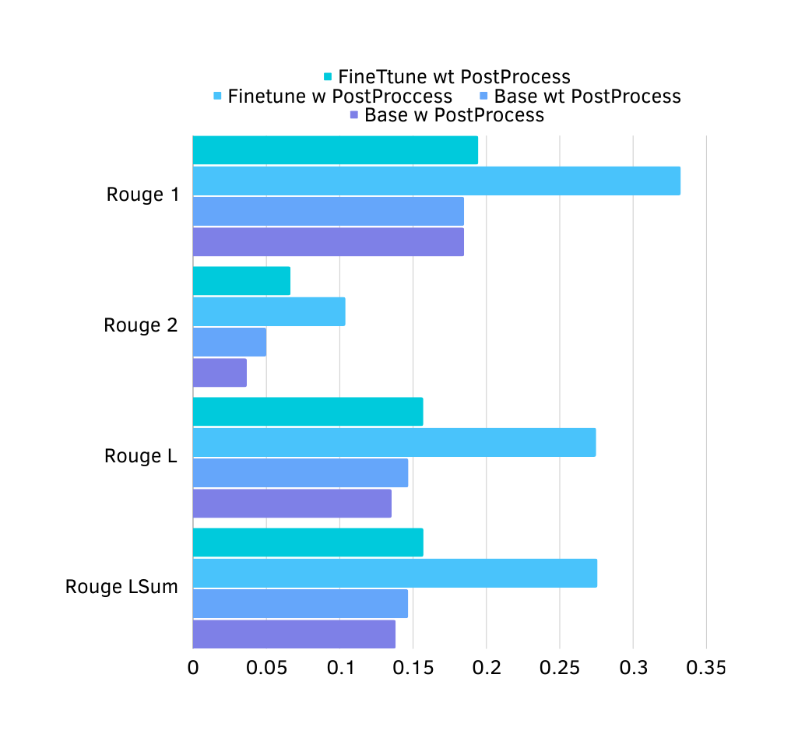
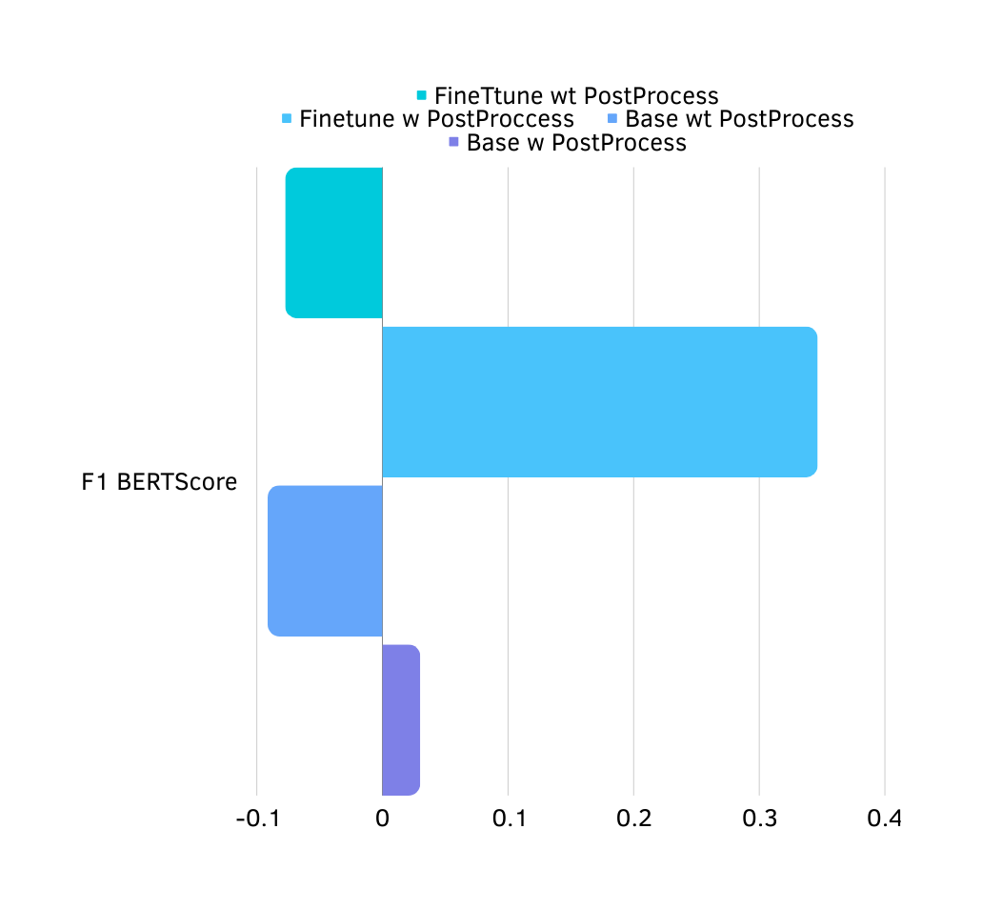
Evaluation: EmojiToSentence

Slide 16
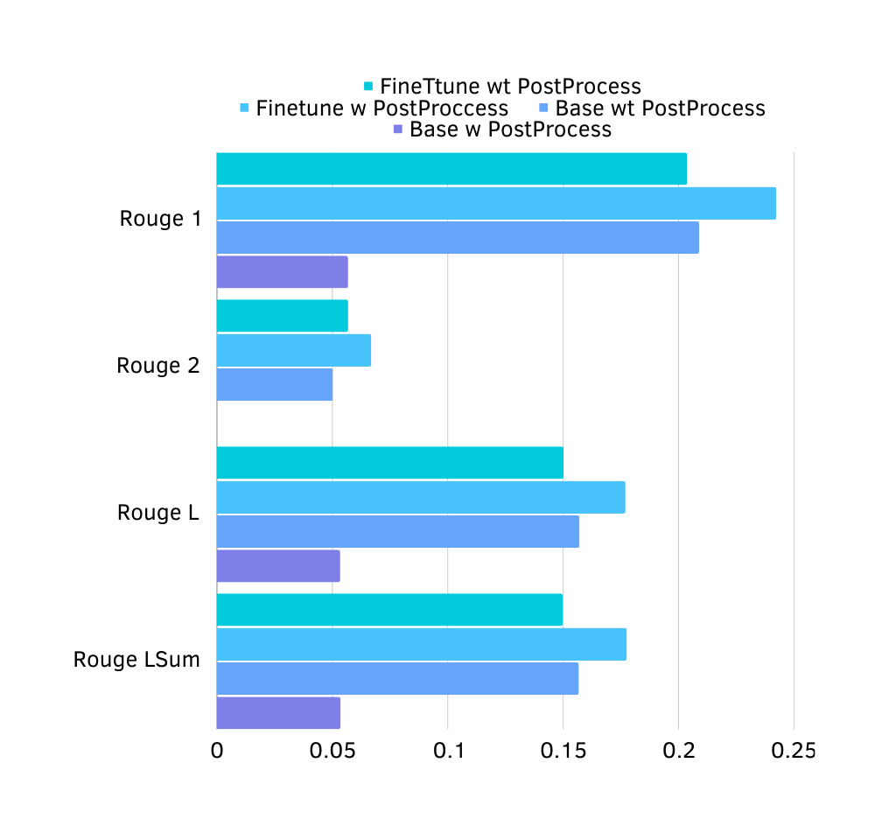
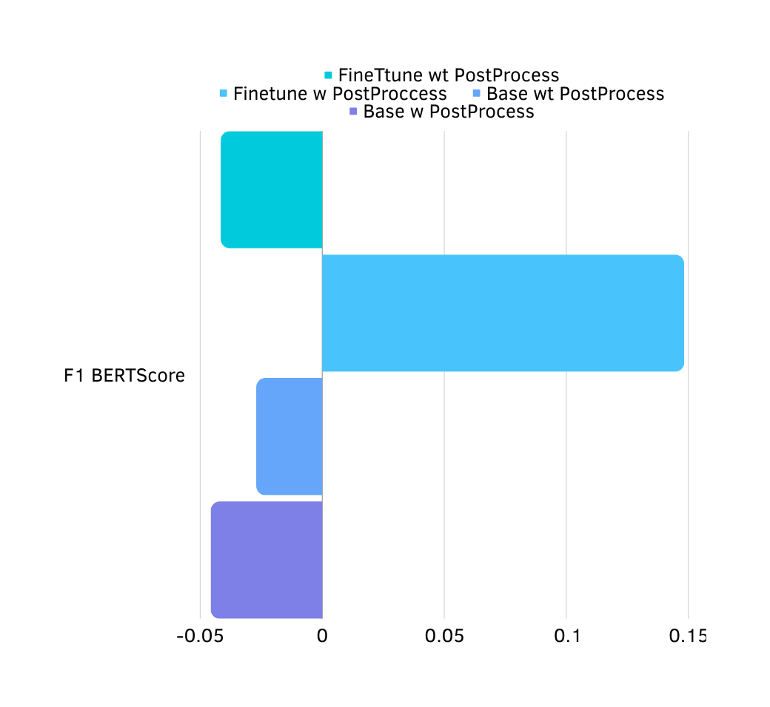
Evaluation: EmojiToResponse

Slide 17
Discord and FineTuned Llama2
response.py
handle the response according to the incoming message
bot.py
using discord API to communicate with discord and get the messages handles how to deal with the incoming message
llama2inferencecleanedipynb.py
handles the model to generate the text handles post proccesing of the generated text

Slide 18
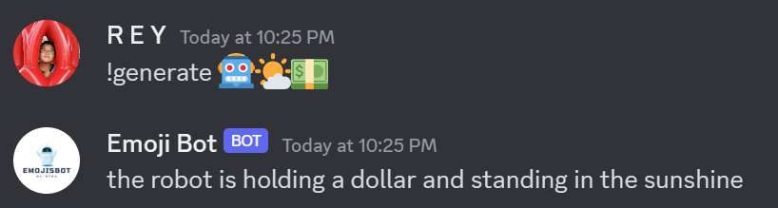
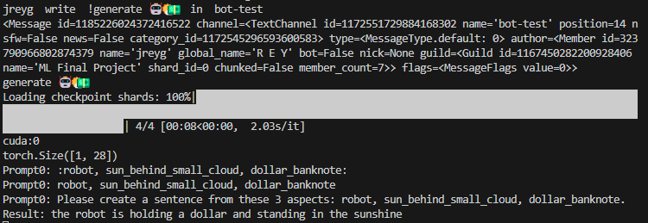
Discord View
Terminal
View

Slide 19
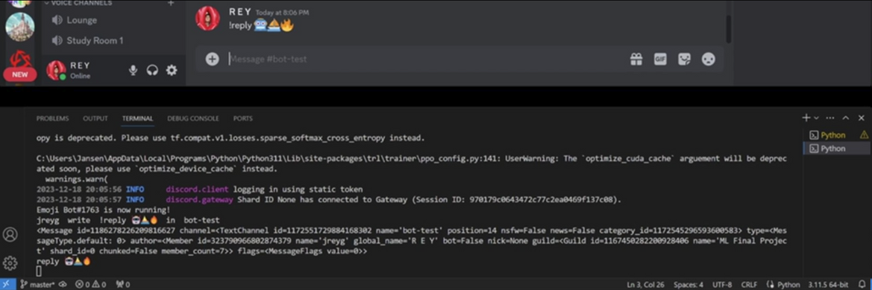
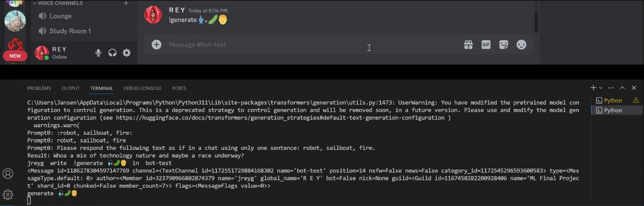
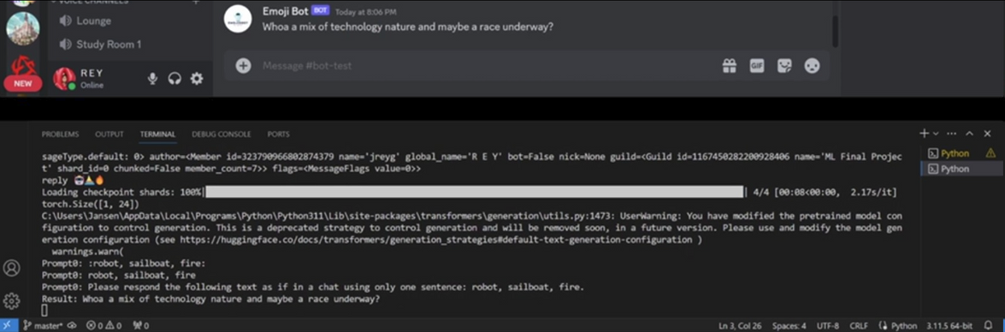
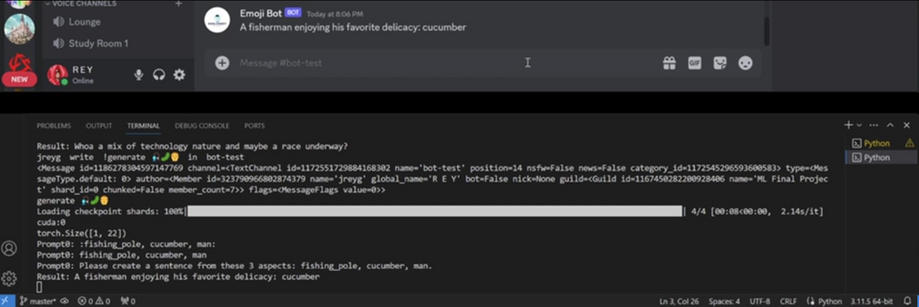
DEMO

Slide 20
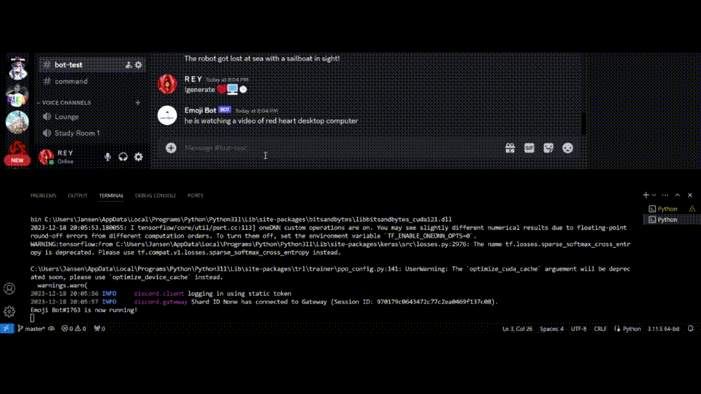
DEMO

Slide 21


Future work : computer vision
To extend the input possibles
Emoji as String Representation
Emoji Label (Text)
Our Model
Sentence
Emoji as an image
Image Classification
Emoji Label (Text)
Our Model
Sentence

Slide 22


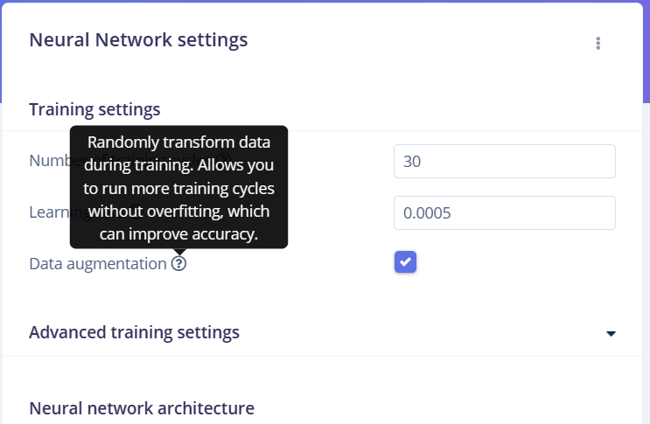
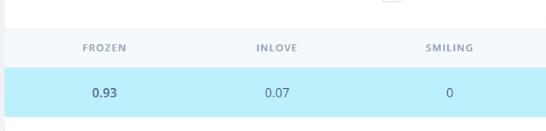
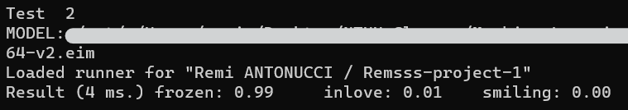
Simple example that we did with the help of a user-friendly website
FULL DATASET COMPLEX TO CREATE, EXAMPLE WITH 3 EMOJIS

Slide 23

Thank
You

